Slide 1
Presented by: Tim Cameron CommIT Project Manager, Internet 2
CommIT Project Update

Slide 2
Current Environment
Todays reality:
Applicants establish separate accounts for every service they consume
Cumbersome and challenging
Applicants are rarely expected to prove their identity until after they have been accepted.
Stakeholders incur significant costs in provisioning and support
Notes:
Todays environment is particularly cumbersome and challenging given that college applicants must establish separate user accounts for each service that they consume, often with little or no true identity proofing until AFTER they have been accepted for admissions to a HE institution.
This process is costly for the service providers to support, and we hope that the CommIT project will alleviate the provisioning and support costs that vendors incur while concurrently strengthening and streamlining the identity proofing of the applicants.

Slide 3
What is CommIT?
Quality Electronic Authentication Solution
Smooth
Reliable
Easily implemented
Designed to streamline the electronic higher education admissions process
Notes:
CommIT is designed to be a smooth, reliable and easily implemented electronic authentication solution to streamline the electronic processes involved in the HE admissions process.

Slide 4
Executive Sponsors
Internet2
National reach of federated identity solution (InCommon)
PESC
Data standards expertise
Notes:
CommIT is being collaboratively developed by its executive sponsors, Internet2 and PESC…bringing together a national reach in the federated identity space and data standards expertise.

Slide 5
Project Goals
Support and Enhance Identity and Trust
CommIT will provide a process for matching electronic records for college applicants and institutions
Federated Single Sign-On Solution (SSO)
Single set of credentials that can be used across various services
CommIT strives to provide a scalable, secure approach to SSO
Only the applicant can initiate record aggregation and release
No third party access to data without applicant consent
Voluntary
Notes:
The fundamental goals of the project are to support and enhance identity and trust by providing a simplified and streamlined process for matching electronic records.
This will be done through a single sign-on solution that is both scalable and secure.
No third party access to data will be allowed without the applicants authorization.
Participation in CommIT is completely voluntary.

Slide 6
Project Goals
Create an Identity Store
Person Registry
Store minimum data required to support user uniqueness and password re-sets
Unique Student Identifier
CommIT will create a unique electronic credential to:
resolve matching problems at the university level,
simplify the entire application process for students, parents, colleges and universities, and their external service providers, and
do away with the last remaining vestiges of dependency on the social security number.
Identity Assurance will be integrated into Phase 2
Ecosystem to support “Digital Notaries”
Notes:
The CommIT solution will be achieved by creating an ecosystem that will include and Identity Store, and Identity Management Provider, a Person Registry, and a Unique Student Identifier.
It is important to note that the Person Registry will only store a minimum set of data to allow for uniqueness and to support password management.
Equally as important is the use of an Unique Student Identifier to assist in the resolution of matching problems faced by HE institutions, to simplify the application process for all involved, and attempt to do away with the dependencies on Social Security Numbers that some organizations still face.

Slide 7
CommIT Core Team
Internet2 has contracted services with Unicon and AWS to:
provide virtual machines to host the pilot project
provide technical assistance.
PESC will lead the business development and community outreach components.
Georgetown University will provide oversight to the project.
Pennsylvania State University will be responsible for implementing the central person registry.
Notes:
The Core Team overseeing the project is made up of staff from Internet2 and their contracted vendors, PESC, Georgetown University and Penn State University who each have unique rolls in this collaborative effort as described here.

Slide 8
Core Team Deliverables
The Core Team will
develop the infrastructure,
provide support and documentation, and
deliver a successful pilot project to which partners can connect their services.
Assist the pilot participants with production implementation and testing.
Notes:
As Shel mentioned, CommIT is being collaboratively developed by its executive sponsors, Internet2 and PESC…bringing together a national reach in the federated identity space and data standards expertise.
The Core Team is charged with developing and documenting the infrastructure to support the CommIT process which is on schedule for delivery early this summer. This team will also assist the pilot participants with their production implementations and testing efforts.

Slide 9
CommIT Technical Team
Technical Update
Reference Architecture
Pilot Ecosystem
Resource Identification
Configuration and Testing
LDAP
IdP
CPR
User Experience
Usability Testing: Round 1
Notes:
From a technical perspective, the team is in full swing of developing the reference architecture and the ecosystem for the pilot phase of the project. The LDAP directory, Identity Provider and Central Person Registry have been configured locally and have recently been migrated to Virtual Machines in the Cloud where they are currently undergoing extensive load balancing and testing.
Unicon has completed designing the User Interface screens and the tech team has identified the functional requirements for the registration page, login page, the home page, and the password reset center as well as those for general information and FAQ’s – essentially everything the user will experience with CommIT.

Slide 10
CommIT Business Team
Business Update
Business Plan
Project Summary and Participation Agreements
Marketing & Communications Plan
Partner Outreach
Website Content Development
Funding Model
Notes:
With the Project Governance Structure being formally adopted by the Steering Committee, earlier last month we formed a new Business Team that is charged with finalizing the formal business plan for the project, including Participation Agreements, a Marketing plan, Partner Outreach activities and to draft a funding model for long term sustainability of the service to be submitted to the Steering Committee.

Slide 11
The CommIT Process

Slide 12
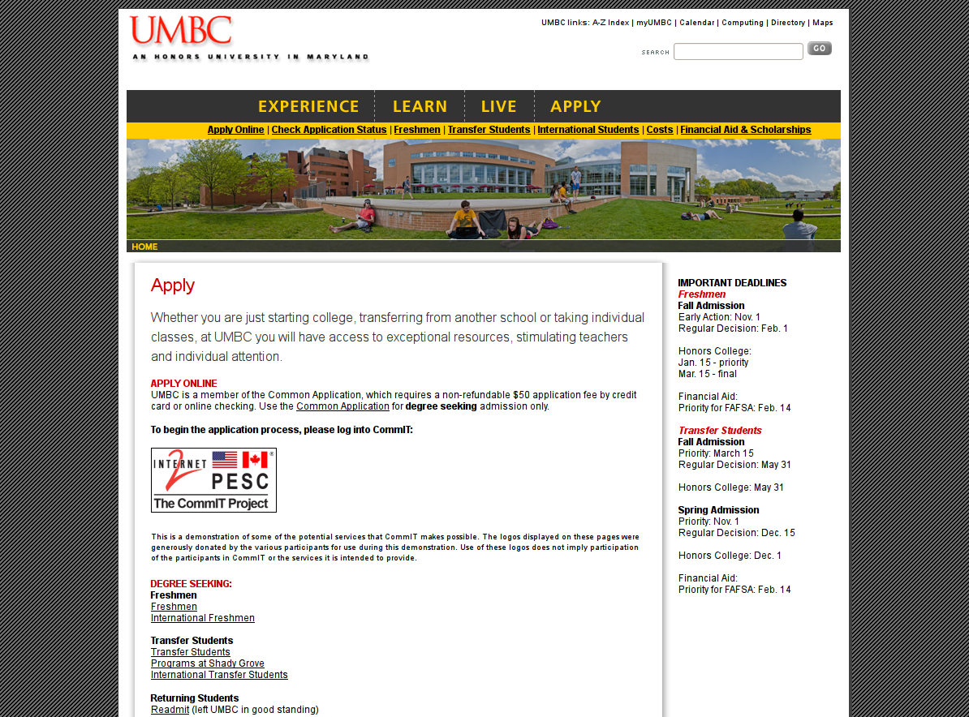

Slide 13
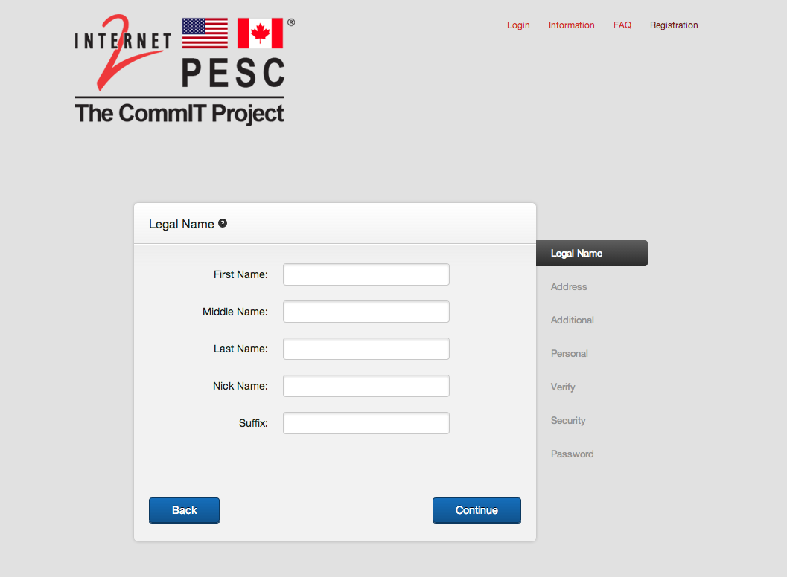

Slide 14
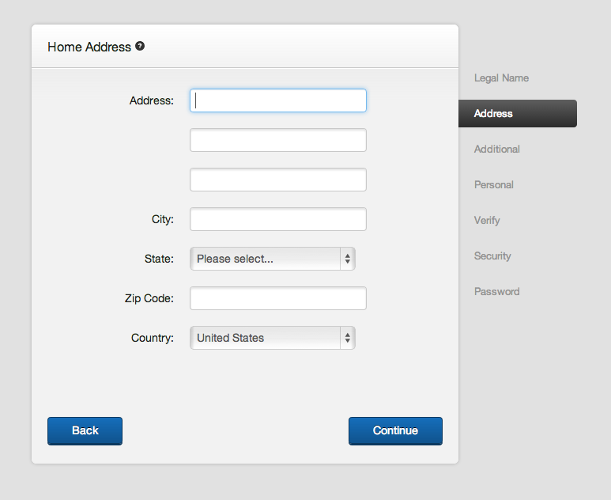

Slide 15
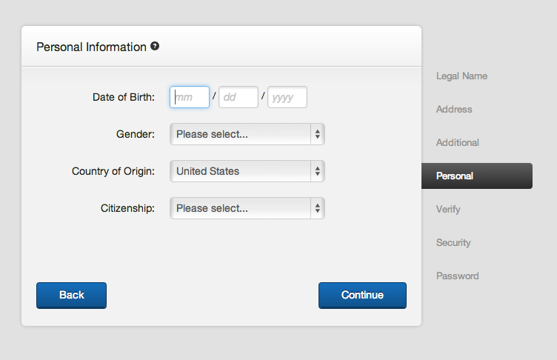

Slide 16
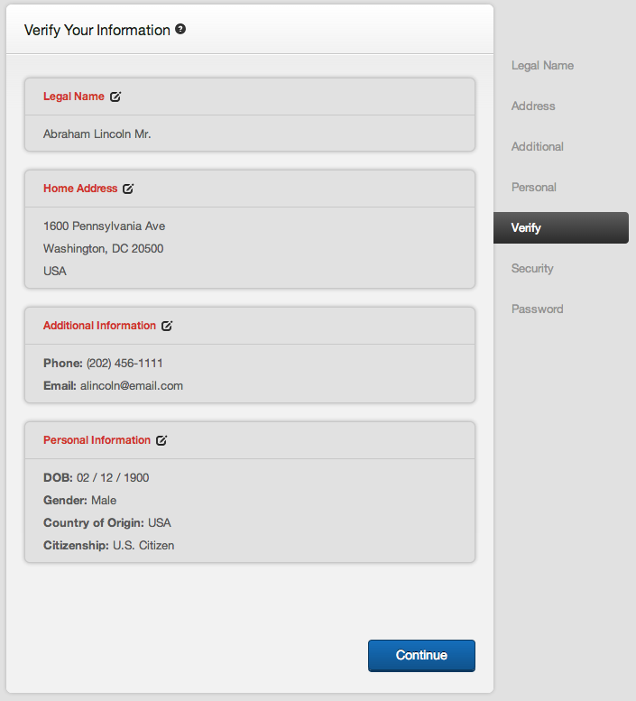

Slide 17
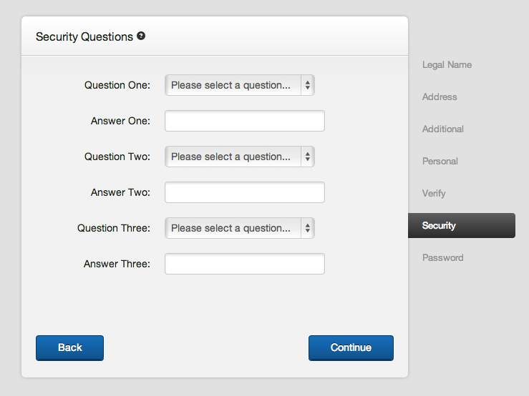

Slide 18
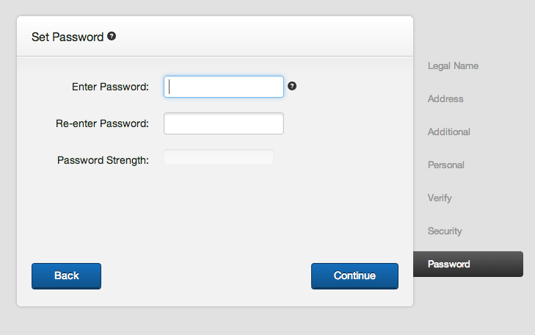

Slide 19
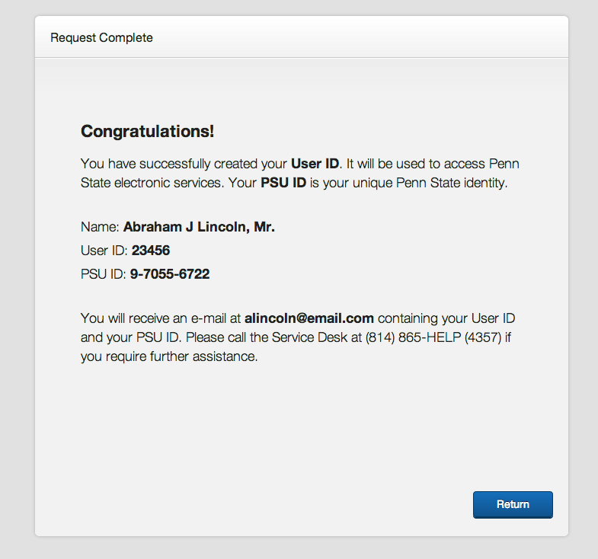

Slide 21
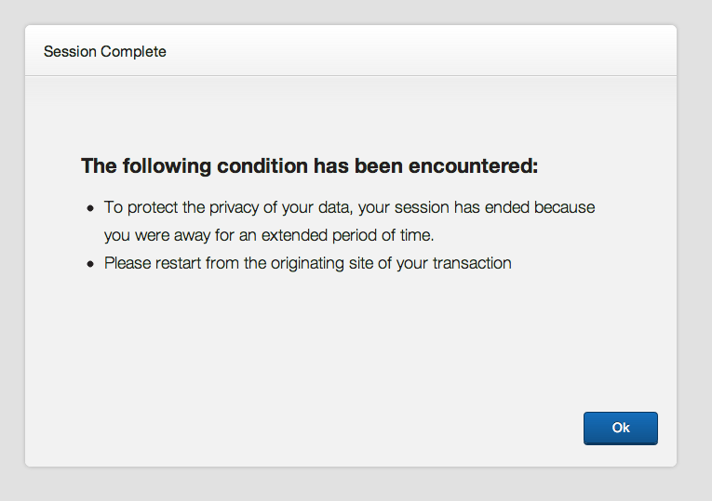

Slide 23
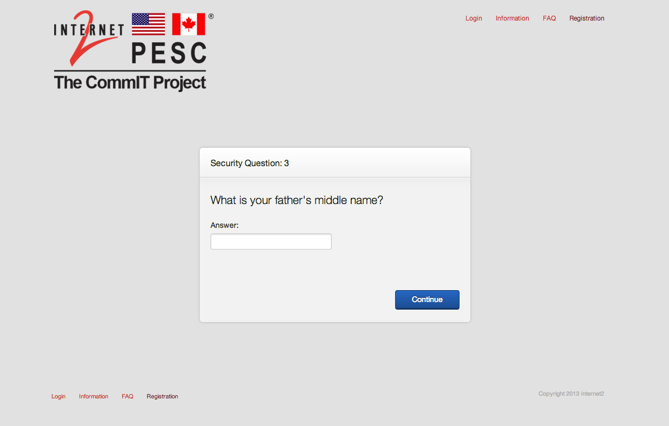

Slide 24
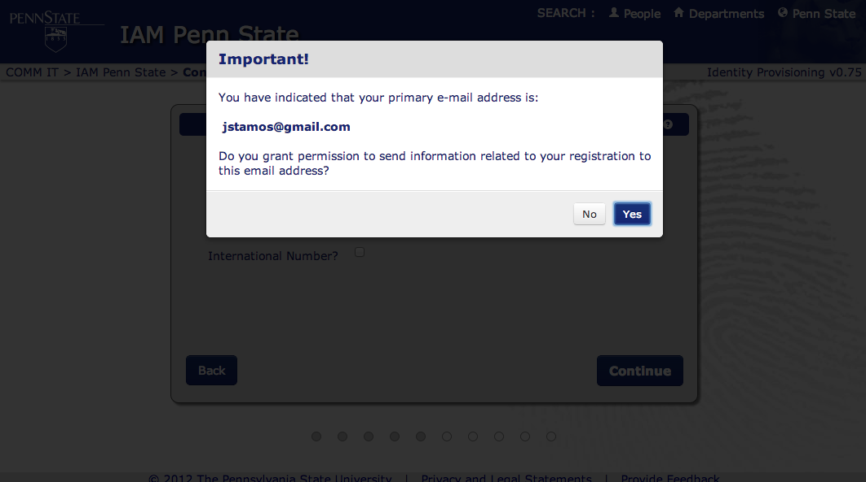

Slide 25
University Participants Deliverables
Universities participating in Phase one of the CommIT Project will have the following requirements:
Through the admissions office, the institution must provide a process for willing prospective students with the option to create and utilize the CommIT process
The university will utilize the unique CommIT identifier to match applicants with records provided through their admissions applications tools.
The university will allow any applicant who possesses a CommIT identity to use their credentials to authorize access to online applications.
Representatives from participating universities will be encouraged to share their experiences and lessons learned at various conferences
Notes:
These next two slides identify the deliverables that will be expected of the pilot participants.
From a school perspective, the requirement is for the admissions office to support the CommIT login process and to tie that to their admissions application tools and to allow applicants to use the CommIT identity to authorize access to online applications.
It is anticipated that pilot schools will identify a subset of their populations for participation in the pilot.

Slide 26
Organizational Partners Deliverables
To participate in CommIT Project Phase one, organizational partners will be responsible for:
Accepting the CommIT credential from applicants who login with them,
Support the storing of this unique identifier, and
Support the capability to attach the unique identifier to all applicant documents that are passed to CommIT participating institutions.
Notes:
From the vendor perspective, participating organization's will be required to accept the CommIT credentials from any applicant that uses CommIT. They will also be required to support the storing of the unique identifier and to pass the unique identifier with any electronic documents that are shared with CommIT participating institutions.

Slide 27
Next Steps
Usability Testing – Round 2
Define Help Desk Requirements
Launch of public website
Identification of Pilot Participants
Transition to “Product” Phase
Notes:
Although much has been accomplished so far this year, there is still a lot of work to be done. As a reminder, the Technical Team will be meeting tomorrow for the first half of the day and the Business Team will be meeting in the afternoon. In addition to demonstrating what has been built thus far, our intention is to work on finalizing outstanding functional requirements, and to talk about functional and usability testing phases. We have an aggressive schedule for this testing – in fact, we are due to begin in 3 weeks! We have a remarkable opportunity to work with a class of High School students before they break for the year to conduct a round of usability testing and we are pulling out all stops to be ready for them!
Additionally, we have finalized the Pilot Participation Agreement and will be sharing that with interested parties tomorrow….
SEGUE to Charlie

Slide 28
Next Steps
Get Involved:
Participate in various working groups to assist with defining:
business, technical, and governance models for the project.
Learn More

Slide 29
Contact Information
Tim Cameron
CommIT Project Manager,
Internet2
tcameron7185@gmail.com
office: +1.954.295.0949

